Slide 1
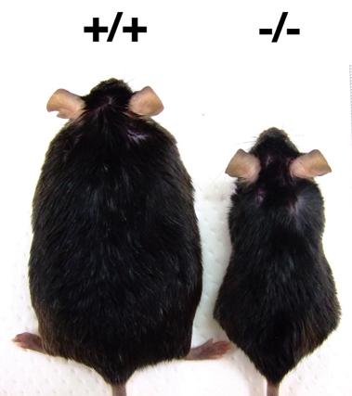
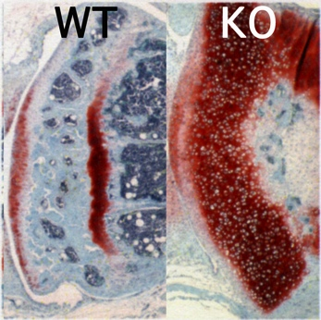
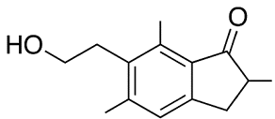
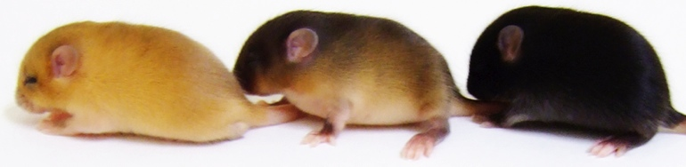
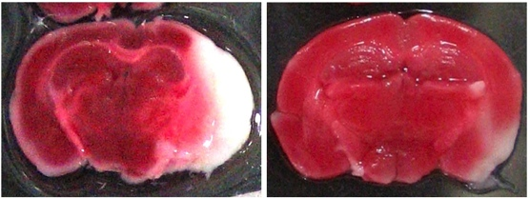
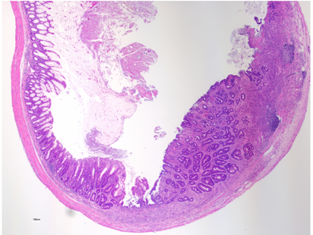
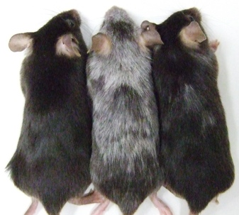
Various roles
Metabolic disease
Energy metabolism
glucose/fatty acid
cholesterol/bile acid
Steroidogenesis
SIK3
Condrogenesis
Pathway
inhibitor
SIK1
SIK2
Pterosin B
Mental
retardation
soft born
Melanogenesis
Skin
whitening
Osteoarthritis (OA)
Innate immunity
SIK2 inhibitor
WT
KO
Smooth muscle
relaxation
4’Met-
Compound A
Fisetin
Colon
Resistance to
oxdative stresses
Stroke
Dementia
Inflammatory
bowel disease
Anti hair graying
Cosmetics

Slide 2
Salt Inducible Kinase (SIK)
Salt-inducible kinase (SIK) is a member of the 5’-AMP-activated protein kinase (AMPK)-related kinase family, and the SIK subfamily is composed of three isoforms. We isolated SIK1 from the adrenals of rats fed with a high salt diet and identified SIK2 by its sequence similarity from the adipose tissue. SIK3 was characterized as an ubiquitously expressed kinase. Although multiple SIK substrates have been identified based on information from the SIK phosphorylation motifs, LX (R/K)(S/T)X pS XXX L, only two types of substrates, CRTC (a coactivator for the cAMP response element (CRE)-binding protein (CREB)) and class IIa histone deacetylase (HDAC) , have been confirmed by independent research groups. Phosphorylation of these two substrates by SIKs results in a loss of their transcriptional regulatory activities by inducing nuclear export. Because these two substrates play vital roles in our bodies, dysfunction of SIKs leads to a number of physiological abnormalities. Major roles of SIKs are listed below.
SIK1
Cloning of a novel kinase (SIK) of the SNF1/AMPK family from high salt diet-treated rat adrenal.
FEBS Lett. 1999 453:135-9
Salt-inducible kinase represses cAMP-dependent protein kinase-mediated activation of human cholesterol side chain cleavage cytochrome P450 promoter through the CREB basic leucine zipper domain.
J Biol Chem. 2002 277:15629-37
ACTH-induced nucleocytoplasmic translocation of salt-inducible kinase. Implication in the protein kinase A-activated gene transcription in mouse adrenocortical tumor cells.
J Biol Chem. 2002 277:42334-43
Salt-inducible kinase-1 represses cAMP response element-binding protein activity both in the nucleus and in the cytoplasm.
Eur J Biochem. 2004 271:4307-19
The CREB coactivator TORC2 is a key regulator of fasting glucose metabolism.
Nature. 2005 437:1109-11
Silencing the constitutive active transcription factor CREB by the LKB1-SIK signaling cascade.
FEBS J. 2006 273:2730-48
SIK2
Adipose-specific expression, phosphorylation of Ser794 in insulin receptor substrate-1, and activation in diabetic animals of salt-inducible kinase-2.
J Biol Chem. 2003 278:18440-7
The CREB coactivator TORC2 functions as a calcium- and cAMP-sensitive coincidence detector.
Cell. 2004 119:61-74
Involvement of SIK2/TORC2 signaling cascade in the regulation of insulin-induced PGC-1alpha and UCP-1 gene expression in brown adipocytes.
Am J Physiol Endocrinol Metab. 2009 296:E1430-9

Slide 3
Downregulation of SIK2 expression promotes the melanogenic program in mice.
Pigment Cell Melanoma Res. 2010 23:809-19
SIK2 is a key regulator for neuronal survival after ischemia via TORC1-CREB.
Neuron. 2011 69:106-19
A potent inhibitor of SIK2, 3, 3', 7-trihydroxy-4'-methoxyflavon (4'-O-methylfisetin), promotes melanogenesis in B16F10 melanoma cells.
PLoS One. 2011 6:e26148
A novel compound ARN-3236 inhibits Salt Inducible Kinase 2 and sensitizes ovarian cancer cell lines and xenografts to paclitaxel.
Clin Cancer Res. 2017 pii: clincanres.1562.2016
SIK3
Involvement of SIK3 in glucose and lipid homeostasis in mice.
PLoS One. 2012 7:e37803
SIK3 is essential for chondrocyte hypertrophy during skeletal development in mice.
Development. 2012 139:1153-63
Salt-inducible kinase 3 deficiency exacerbates lipopolysaccharide-induced endotoxin shock accompanied by increased levels of pro-inflammatory molecules in mice.
Immunology. 2015 145:268-78
Salt-inducible Kinase 3 Signaling Is Important for the Gluconeogenic Programs in Mouse Hepatocytes.
J Biol Chem. 2015 290:17879-93
Nat Commun. 2016 24:10959
Pterosin B prevents chondrocyte hypertrophy and osteoarthritis in mice by inhibiting Sik3.
Related studies
Altered Actions of Memantine and NMDA-Induced Currents in a New Grid2-Deleted Mouse Line.
Genes. 2014 5:1095-114
Callicarpa longissima extract, carnosol-rich, potently inhibits melanogenesis in B16F10 melanoma cells.
J Nat Med. 2016 70:28-35
A Simple Method for Labeling Human Embryonic Stem Cells Destined to Lose Undifferentiated Potency.
Stem Cells Transl Med. 2016 5:275-81
Simple chronic colitis model using hypopigmented mice with a Hermansky-Pudlak syndrome 5 gene mutation.
Pigment Cell Melanoma Res. 2016 29:578-82

